Slide 1
INF10025
Data Management and Analytics
Week 04 – Part 1
Power BI
Importing Data

Slide 2
Microsoft Power BI
Microsoft have a number of Business Intelligence (BI) products / applications
Power BI is a suite of desktop & cloud based web application that allows you to analyze datasets.
The datasets can be local or cloud based and may be connected to / imported from RBDMSs, Spreadsheets, on-line data services etc.
Power BI can be added to the Office 365 suite of applications.
Through Power BI web app, users can analyze data with various visualizations and dashboards.
One dataset may produce many different visualizations
  Best performing customers
  Worst performing salespeople
  Upward trending products
  Complimentary product sales

Slide 3
Microsoft Power BI
Power BI Desktop is a different product from Power BI web app.
Desktop is a Windows application.
It must be installed on a computer running Windows (or via a virtual Windows OS on a MAC or Linux)
Importing data / manipulating data / writing formula / creating measures is done using the Desktop app.
Once visualizations / reports / dashboards have been created, then they are deployed to a cloud service so that Power BI web app can be utilized.
Power BI Desktop is most often used by BI analysts & developers
Power BI web app is used by end-users and BI analysts.

Slide 4
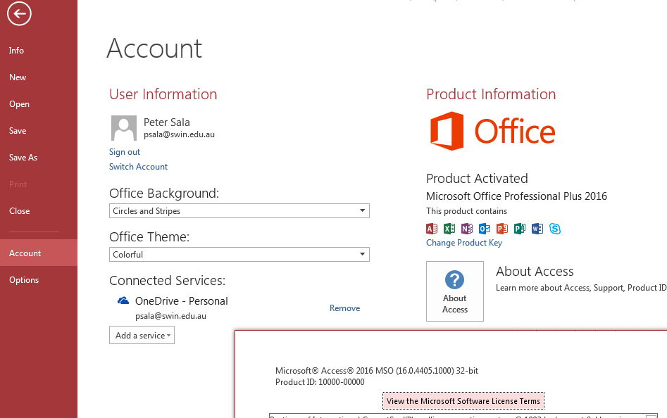
Microsoft Power BI Desktop
Business Intelligence software.
Power BI Desktop is a Windows
only application.
Problem:
One known problem exists when PBI
connects to an Access Database:
Both apps must be the same OS version
  If Access is 32bit then download Power BI 32 bit
  If your Access is 64 bit then download Power BI 64 bit
All Swinburne labs have 64bit Access and 64 bit Power BI Desktop (needs to be access via Apps on demand).

Slide 5
Microsoft Power BI help
If you plan to install a version of Power BI on your own computer, then these links may be useful:
What version of Office am I using?
https://support.office.com/en-us/article/What-version-of-Office-am-I-using-932788b8-a3ce-44bf-bb09-e334518b8b19
Resolve Issues Importing Access Databases in Power BI Desktop
https://powerbi.microsoft.com/en-us/documentation/powerbi-desktop-access-database-errors/
Download Microsoft Power BI Desktop
https://www.microsoft.com/en-us/download/details.aspx?id=58494

Slide 6
Microsoft Power BI Desktop
In the next week or two, we will concentrate on Power BI Desktop.
We will create datasets, reports, dashboards.
We will not deploy / upload reports & dashboards to a cloud service yet.
PowerBi gets updated every year so the following slides may not appear exactly as is shown by whatever PowerBi version you are using. However the concepts on their use is the same

Slide 7
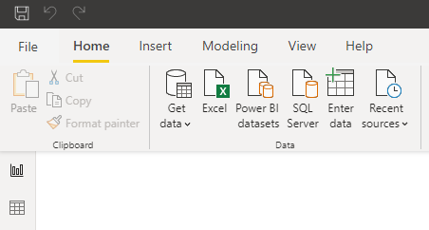
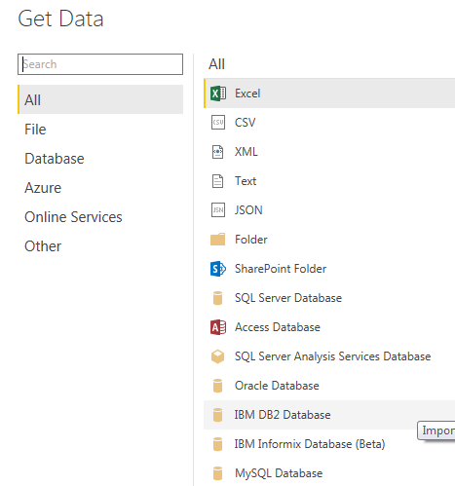
Microsoft Power BI Desktop
Begin the Power BI Desktop application.
Start with selecting the Get Data option
The application can connect to / import data
from many popular sources (including
non-Microsoft applications).
We will concentrate on connecting to Access
Database sources.
If you cannot connect to Access (usually because of the 32bit
vs 64 bit problem), then you will need to export data from
tables to a CSV files. Finally you will import the CSV files into
Power BI Desktop. A bit messy – but easily done.

Slide 8
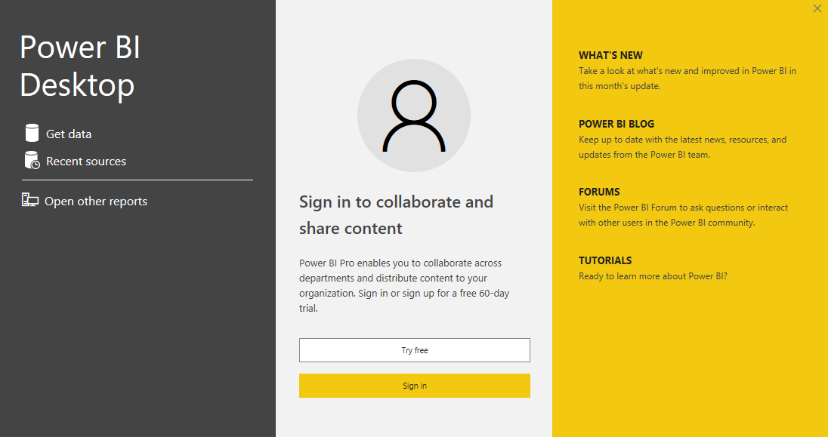
Microsoft Power BI Desktop
Depending on what version of PowerBi you have ,you can select Get Data from the first pop-up

Slide 9
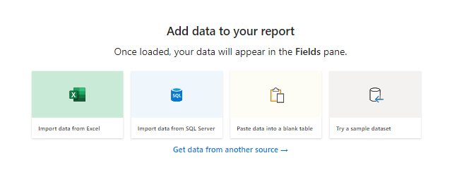

Microsoft Power BI Desktop
Some other versions will show this screen and you select get data from another source and then select Access

Slide 10
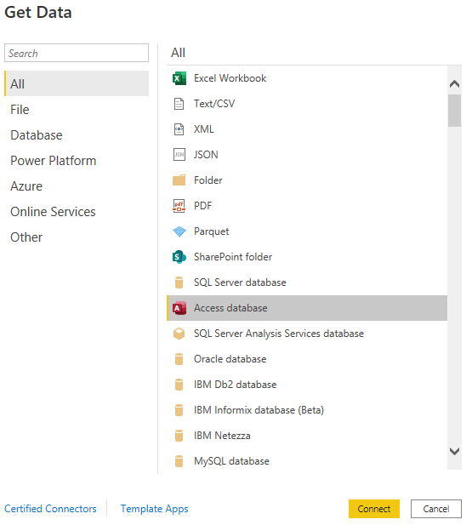
Microsoft Power BI Desktop
Then you will select Access and Connect

Slide 11
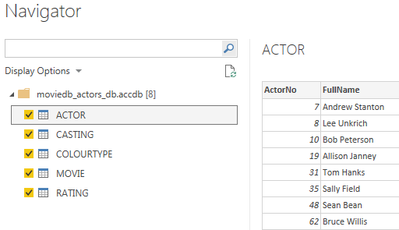
Microsoft Power BI Desktop
Typically, you will have to choose which tables you want to connect to.
You can also connect to queries (or views as they are called in other RDBMSs)
There is no difference between a Table and a Query from the Power BI point of view.
Both present data as a collection of records made up of multiple fields.

Slide 12
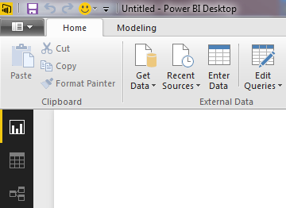
Microsoft Power BI Desktop
There are 3 work area icons on the left of the Power BI screen.
Report, Data and Relationship
Report Window – Where you add visualizations
Data Window – Where you view raw data, add columns & formula
Relationships Window – Where you view / create relationships between tables

Slide 13

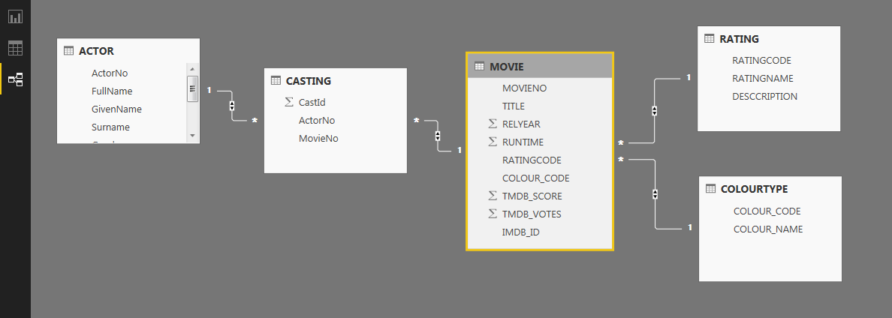
Power BI Relationships Window
The relationships that you created in Access are transferred to Power BI
You can add additional relationships as required.
(e.g. when data is added from other sources)
The symbols differ slightly from Access

Slide 14
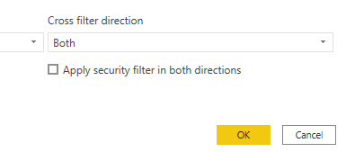
Power BI Relationships Window
Once in the relationship window you need to ensure the relationships between tables are properly joined by doing the following:
Go to each relationship line( they should have a One way arrow on them) Double click on it and go to Cross filter section and select BOTH
Repeat this for all the lines and then each line will show 2 way arrows

Slide 15
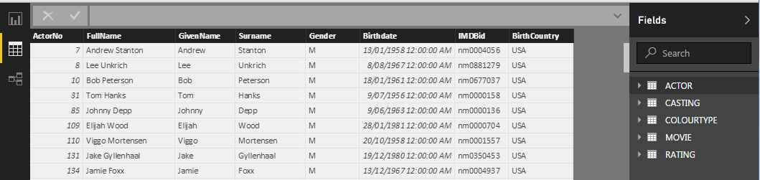
Power BI Data Window
The Data Window is where you
Add additional columns / measures to the dataset
Remove unwanted columns
Write DAX (Data Analysis Expressions) formula. DAX formula are similar to Excel formula plus the inclusion of additional functions designed to work with relational data and perform dynamic aggregation. We will look at DAX formula later in the semester.

